Slide 1
Ghana Card System: Entity-Relationship (ER) Diagram
Contents
1.Introduction 5. Card Information
2. Entities 6.Picture of ER Diagram
3. Attributes 7. Conclusion
4. Relationships

Slide 2
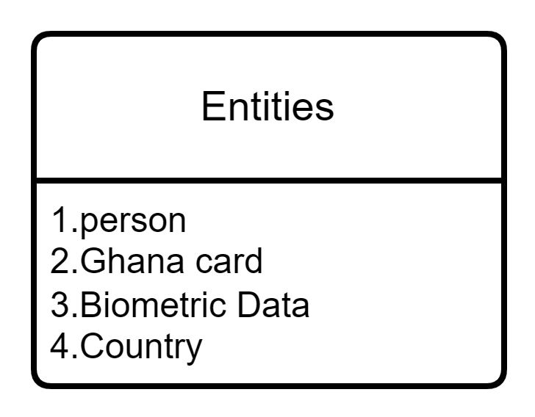
ENTITIES

Slide 3
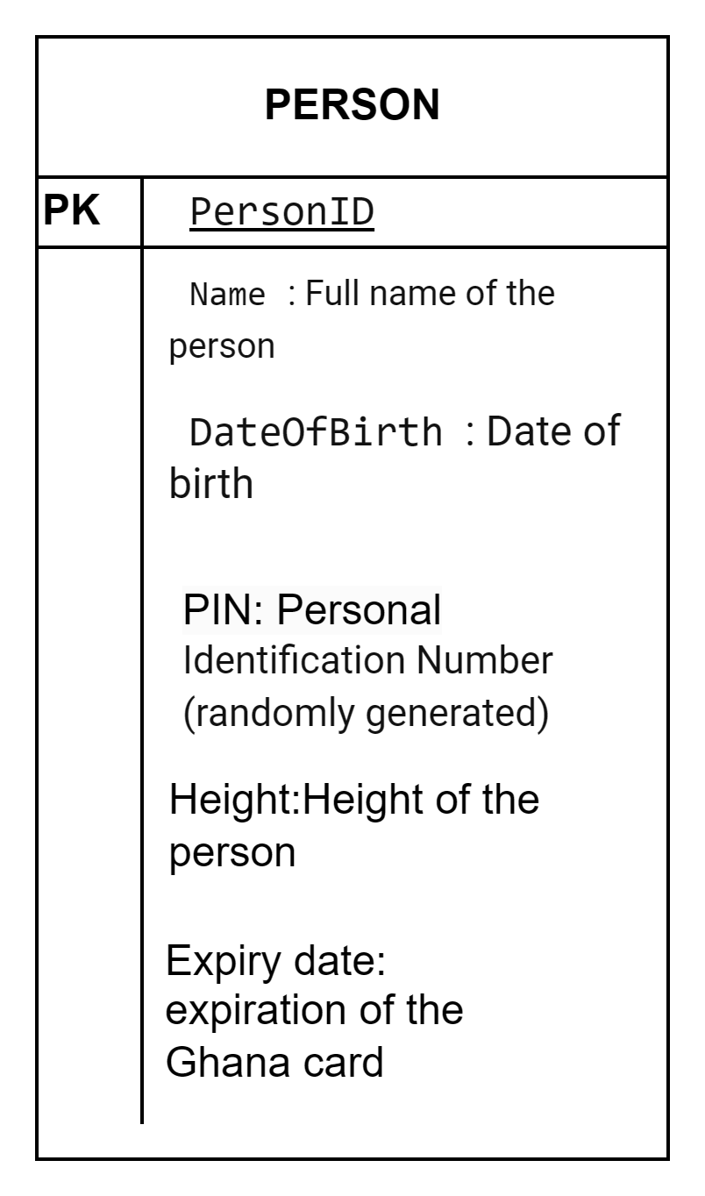
Person
Person ID (Primary Key)
Name
Date Of Birth
Height
PIN (Personal Identification Number, randomly generated) Expiry Date
Digital house address

Slide 4
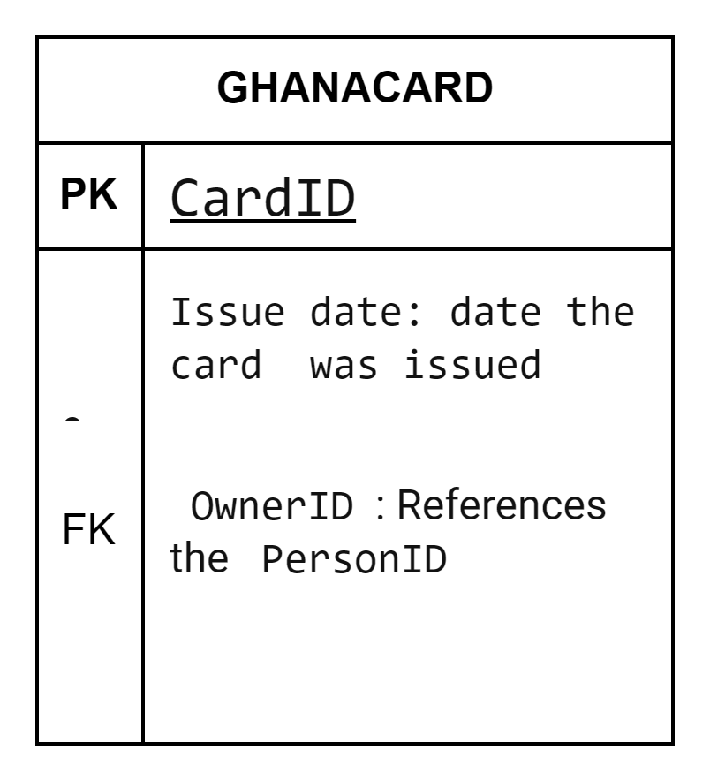
Ghana card
Ghana Card:
Card ID (Primary Key)
Issue Date
Owner ID (Foreign Key referencing Person ID)

Slide 5
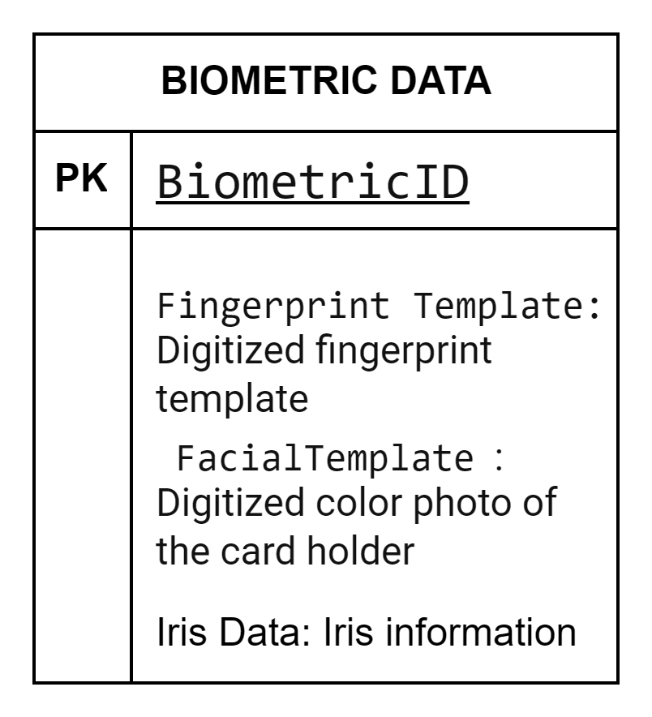
Biometric Data
Biometric ID (Primary Key) Fingerprint Template Facial Template
Iris Data

Slide 6
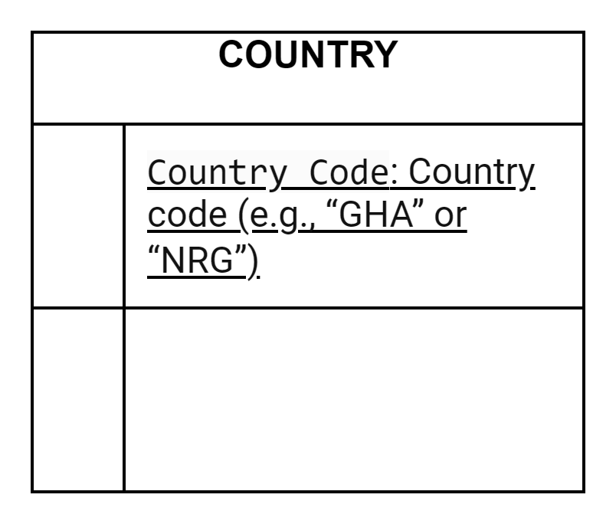
Country
Country Code

Slide 7
Relationships
Our ER diagram captures the following relationships:
Person-Ghana Card: One-to-One relationship. Each person has only one Ghana Card.
Each Ghana Card belongs to only one person.
Person-Biometric Data: One-to-Many relationship
Each person can have multiple biometric data entries. Biometric data is associated with one person.
Ghana Card-Country: Many-to-One relationship Each Ghana Card belongs to a specific country.

Slide 8
Card Information
The Ghana Card contains:
Personal photo
Name
Date of birth
Height
Expiry date
2D barcode or Machine Readable Zone (MRZ) with biometric information (fingerprints and signature)

Slide 9
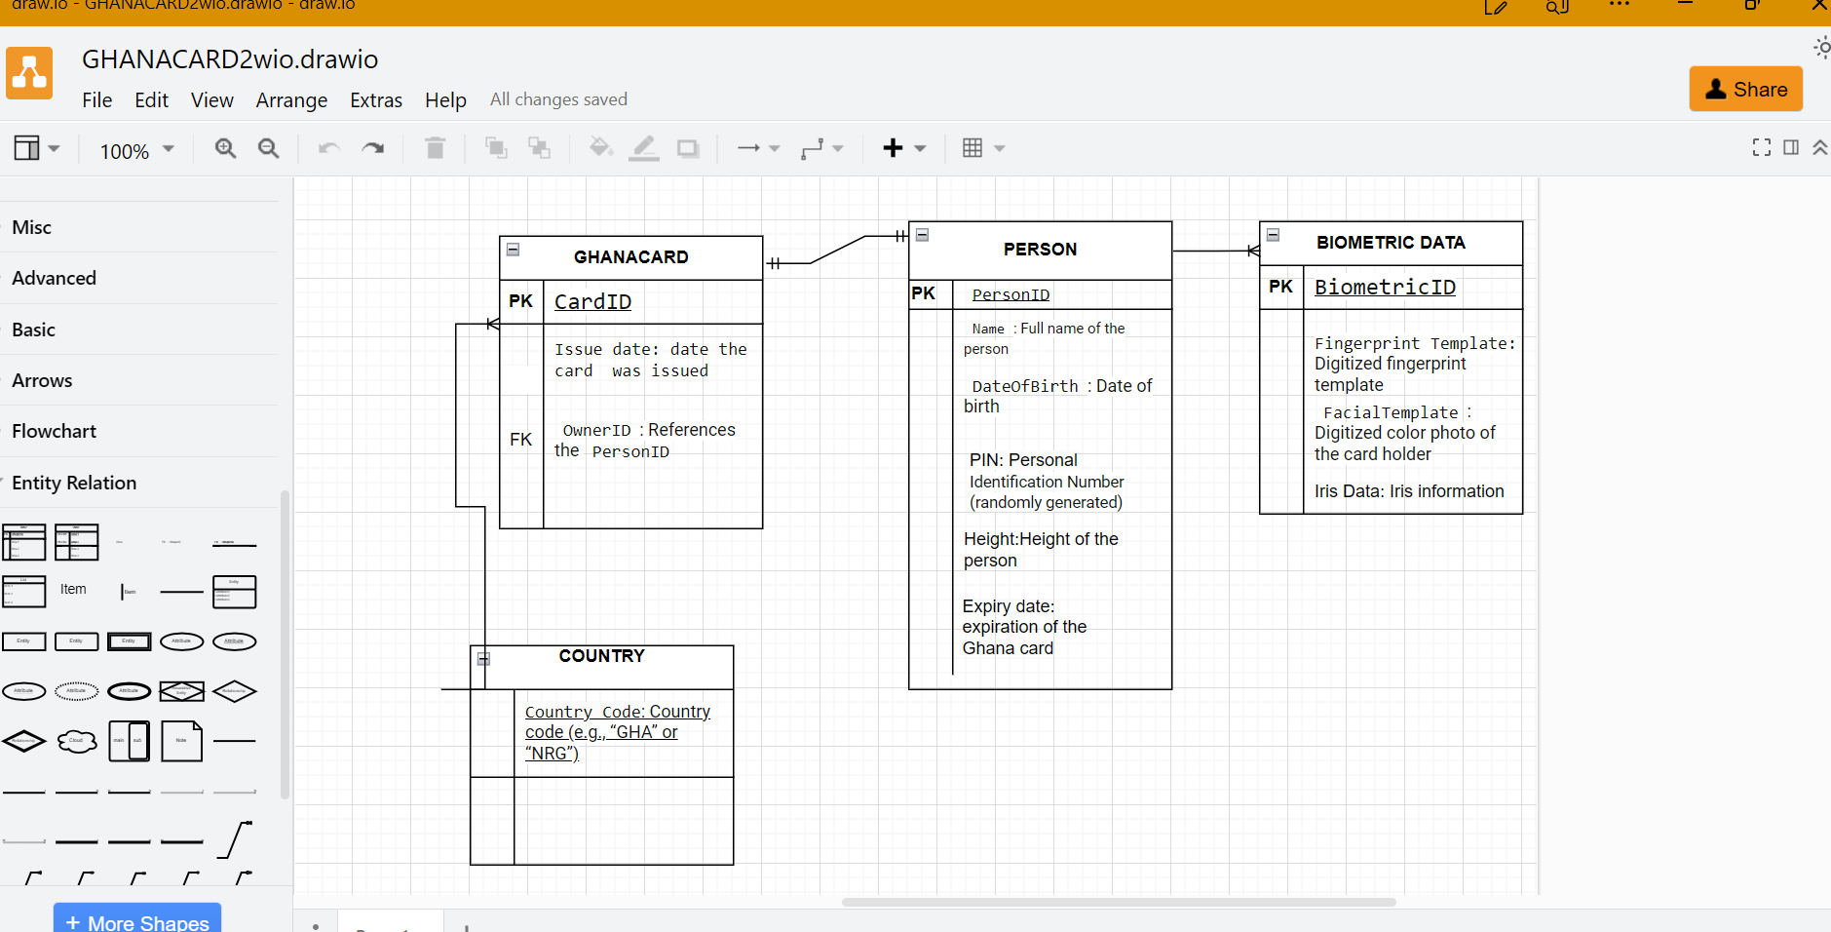
Er diagram of the ghana card

Slide 10
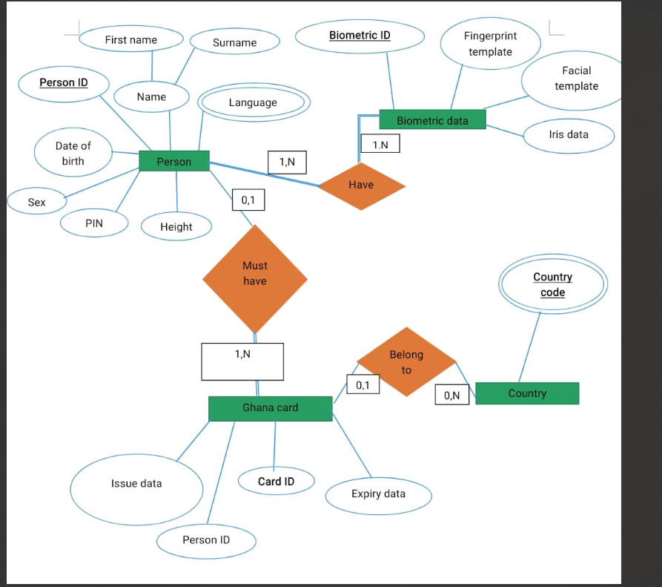
ER DIAGRAM OF GHANA CARD

Slide 11
Conclusion
In summary, the GhanaCard system leverages this ER diagram to manage personal identification, biometric data, and card issuance.

Slide 12
GROUP MEMBERS
HEARTWILL ARKO ADJEI FRIMPONG 052242620009 A
FRANCIS AGYEMANG 052242620005
NAA YARLEY 052242620006
TEDDY BOAMAH 052242620011
UMAR MOHAMMED 052242620007
TARIQ IBRAHIM 052242620010
ASEDA MARSELLs SAMUELLA KAFUI 052242620008
ESTHER RACHEL ADU ADJEI 052242620004
DAVID OTITIAKO 052242620003
O
Aboagye Nsiah Samuel 052241340001
Tsiba Tony 052241340004
Arabi Saadiku 052241340006
Abotsi Dominic 052241340003
John Zumale 052241340005

